Slide 1



REAL TIME FACE EMOTION RECOGNITION
TEAM MEMBERS
4NM20IS168 - V K KIRTHI
4NM20IS173 - VAISHNAVI U SHETTY
1

Slide 2

INTRODUCTION
Recognizing facial expressions would help systems to detect if people were happy or sad as a human being can
This will allow software’s and AI systems to provide an even better experience to humans in various applications The technology is said as emotive Internet
The system works on CNN (convolutional neural network) for extracting the physiological signals and make a prediction
2

Slide 3
OBJECTIVES
facial expression recognition using attentional convolution neural network
User just have to run the project and the system will automatically fetch the emotion from the webcam or camera and label the emotion he made during that time
Different emotion types are detected through the integration of information from facial expressions, body movement and gestures, and speech
3

Slide 4
METHODOLOGIES
Algorithm
CNN(Convolutional Neural Network)
The process involve the use of a large set of annotated data that is fed into the algorithms for the system to learn and predict the appropriate emotion. This system can detect the Live Emotions of the particular user, system compares the information with a training dataset of known emotion to find a match.
Tools Used: Jupyter,Python,OpenCV,Tenserflow
4

Slide 5
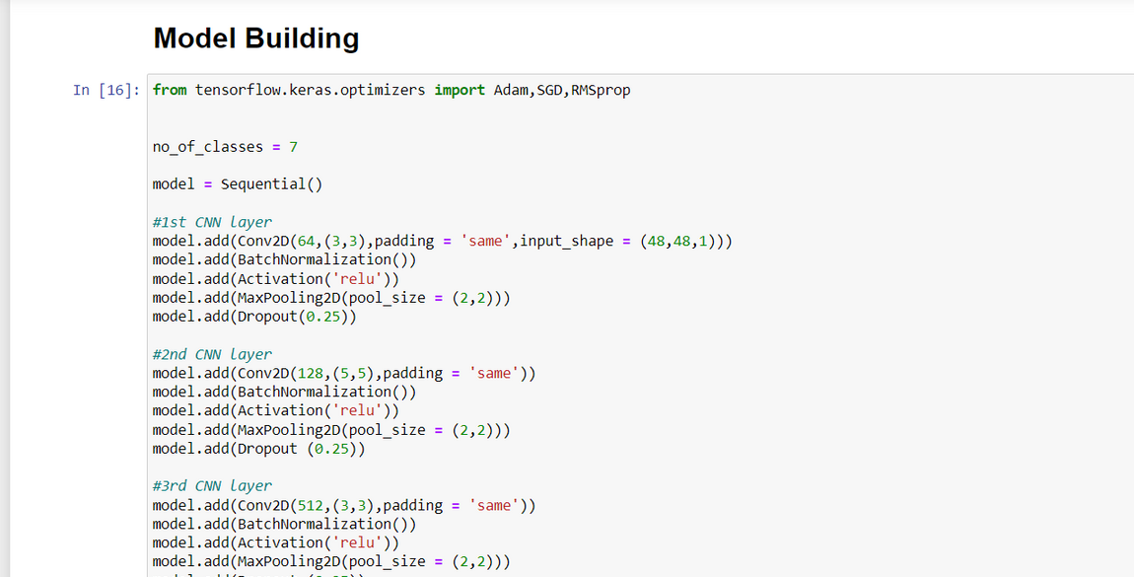
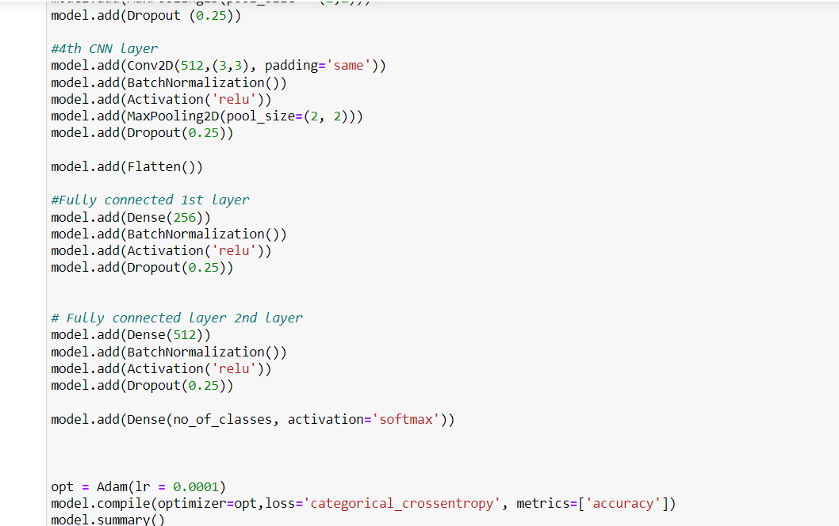
ALGORITHM
5

Slide 6
CNN
We use 4 CNN layers followed by 2 dense layers to create our model, followed by the output layer .
DROPOUT
0.25 percent of dropout in each layer to prevent the overfitting .
ACTIVATION FUNCTION
We use relu as the activation function for all the initial layer , for the final layer we use softmax since there are more than 2 kinds of categories to classify .
6

Slide 7
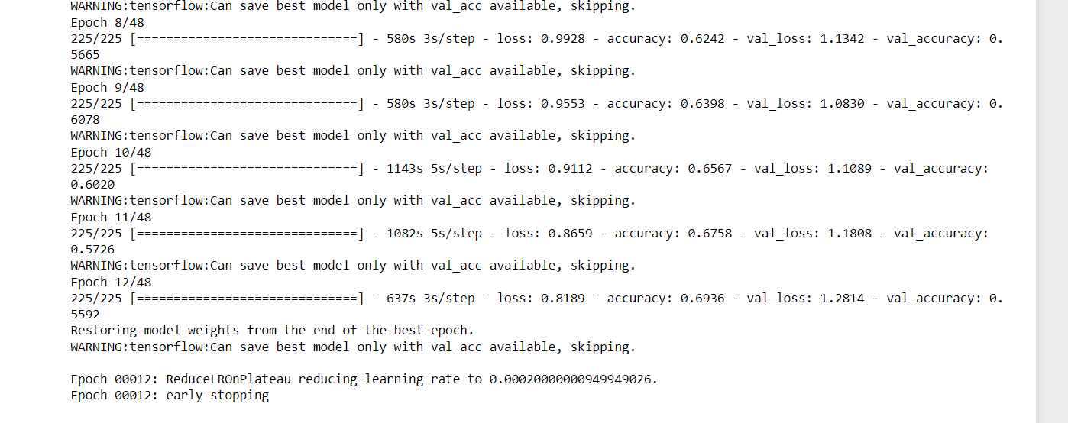
ACCURACY
We have achieved an accuracy of 69.36% .
EARLY STOPPING
The total number of epochs given is 48 .
Due to Early Stopping, it will end at 12 epochs .
7

Slide 8
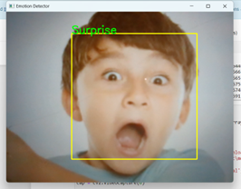
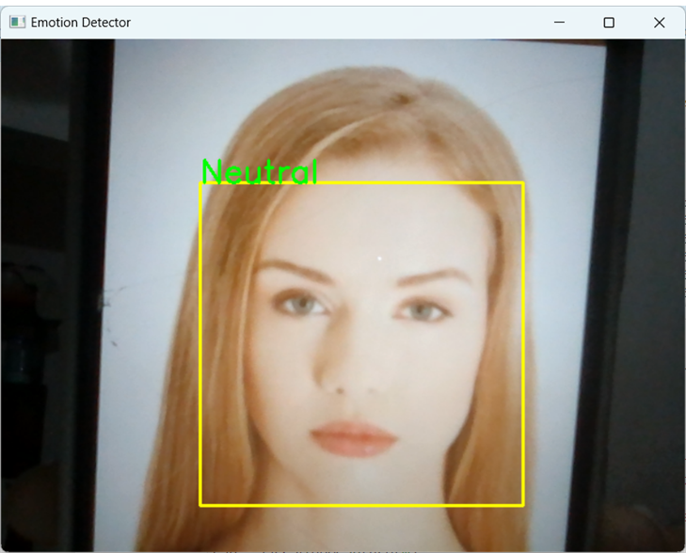
RESULTS
8

Slide 9
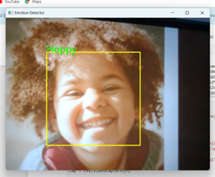
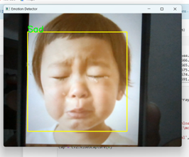
9

Slide 10
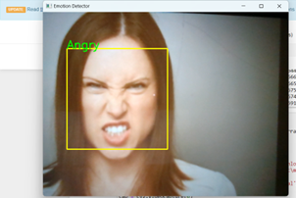
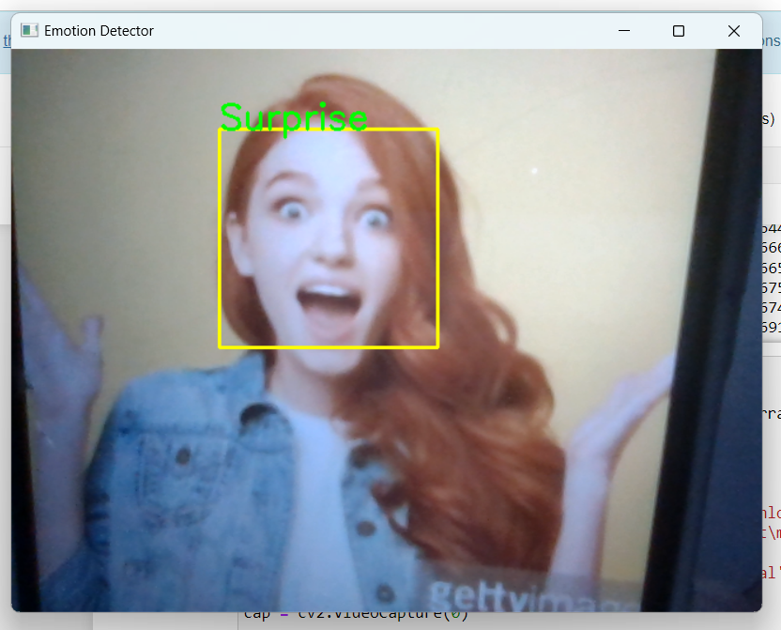
10

Slide 11
REFERENCES
https://towardsdatascience.com/face-detection-recognition-and-emotion-detection-in-8-lines-of-code-b2ce32d4d5de
https://www.ibm.com/topics/convolutional-neural-networks
11

